Slide 1


Building a WebVR environment to bring historical shipping data alive
L. Calisto, I. Dobraja,Y. Gu, A. Weber, J. v Lottum, M. Huetink, M. J. Kraak
August 31, 2018

Slide 2
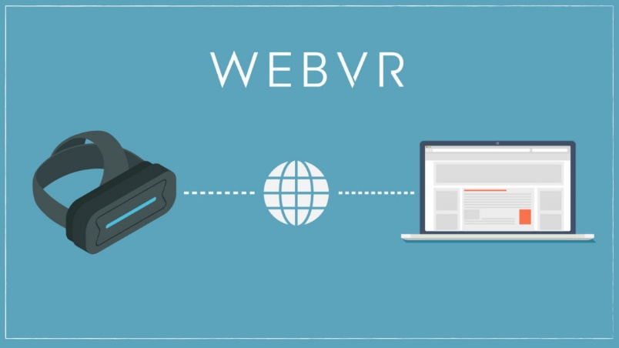
What is webvr
Open specification that makes it possible to experience VR in your browser using web technology!
Works on multiple devices
Frameworks:
A-frame https://aframe.io/
React 360
https://webvr.info/

Slide 3
Our questions
Can WebVR be used to Display, Explore, Analyze Geodata?
What technology can we use?
- Native (Unity) vs Web (A-frame)
What techniques? Not technology!
Is VR for exploration of spatio-temporal data?
Which ways can 2d maps be displayed in VR?
Can we use panels?
Local data VS global data?

Slide 4
Main question
Can WebVR deal with geodata? How?

Slide 5
The data: Legal pirates: The Prize Papers
When the Royal Navy vessel or a private man-of-war captured an enemy ship, a court needed to establish whether the vessel was in fact a lawful prize
To determine this, crew members were cross-examined (interrogated) about all matters relating to the ownership of the ship and its cargo
From 1652 to 1815

Slide 6
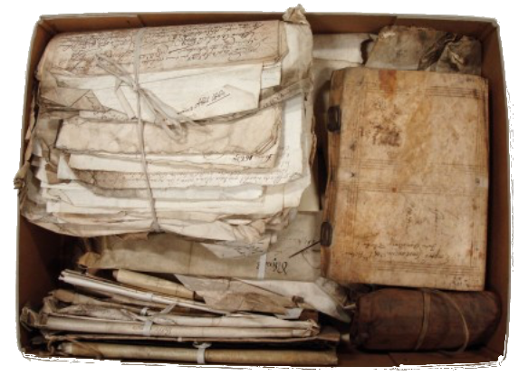
Legal pirates: The Prize Papers
The digitized interrogations of the Prize Papers are vast and valuable collection of judicial documents, private and official letters, shipping lists, and ledgers covering the period between 1652 and 1815.

Slide 7
The Prize Papers Dataset
Trade routes
Shipped commodities
Migration patterns of maritime personnel
Merchant networks
Labor relations on board
Political status:
American Revolutionary War
Anglo-Dutch Wars
War of the Spanish Succession
Napoleonic Wars

Slide 8
The Prize Papers Dataset
Excel datasheet

Slide 9
The Prize Papers Dataset
Too much data, it’s easy to create visual clutter.

Slide 10
More questions
Do we have tools to publish maps in WebVR?
Can we use WebVR in the Prize Papers dataset?
Will VR make it easier to explore the dataset?

Slide 11
aframe-openlayers-component
A-Frame component that allows OpenLayers maps inside WebVR.
Still under development
Fell free to fork, add issues and contribute if you like
https://github.com/lcalisto/aframe-openlayers-component

Slide 12
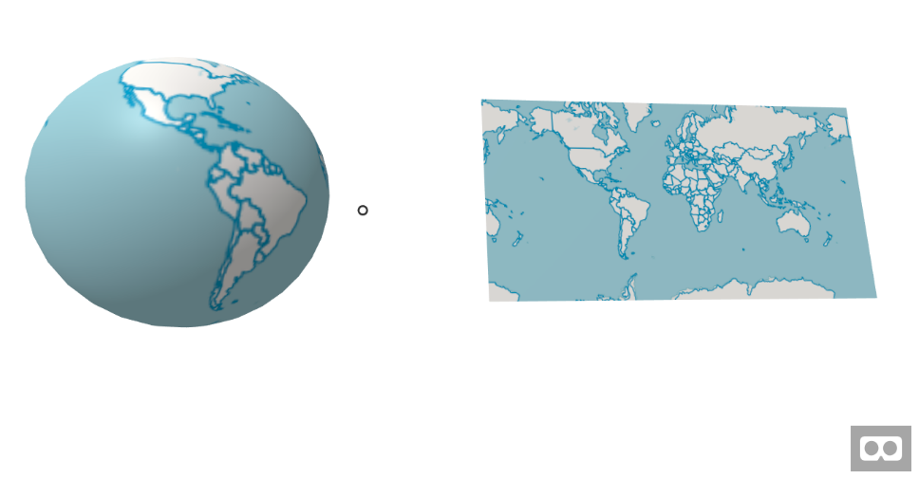
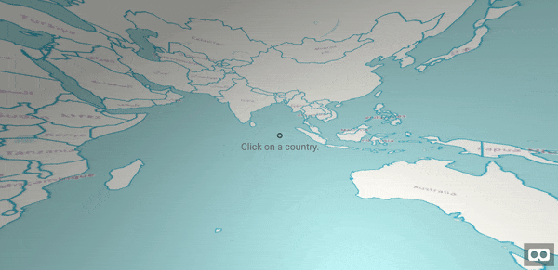
aframe-openlayers-component
Examples

Slide 13



prize papers VR environment
Backend

Slide 14
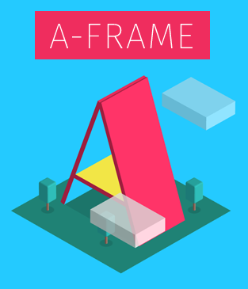
prize papers VR environment
Frontend
Plain Javascript (bad choice!)
Html
A-frame
aframe-openlayers-component
aframe-gui
a-framed

Slide 15
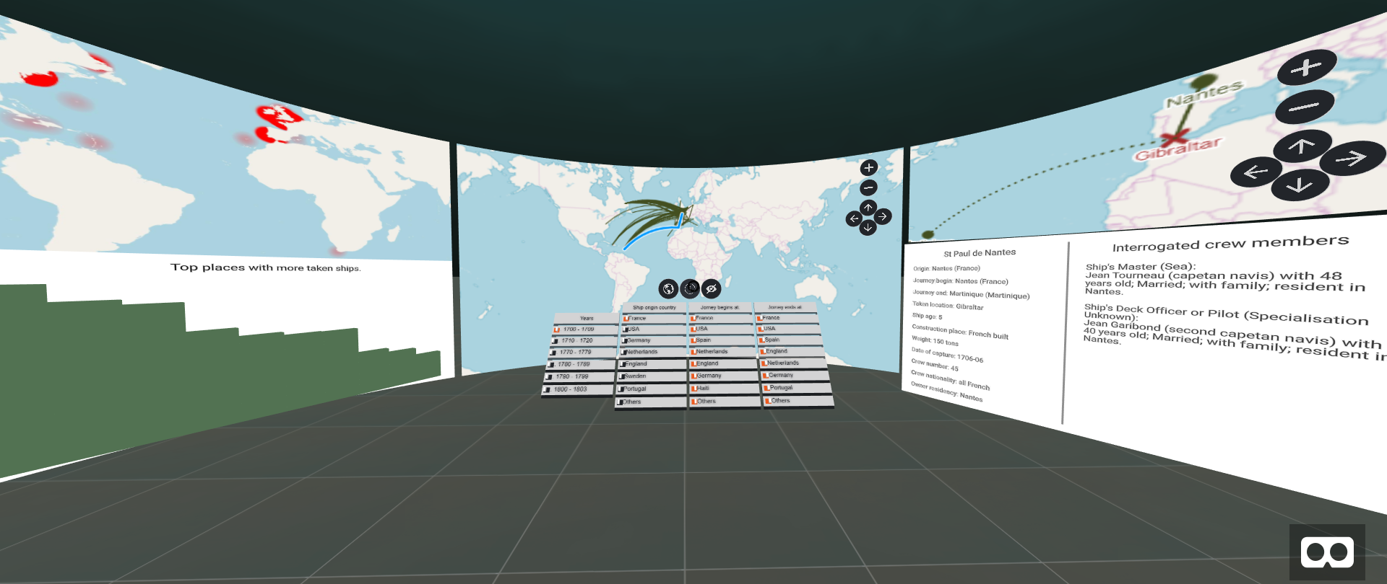
prize papers VR environment
Panels mode
https://vr.calisto.pt/prizepapers

Slide 16
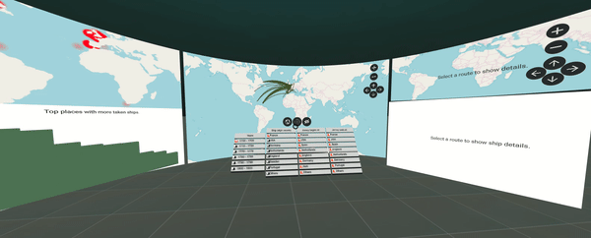
prize papers VR environment
Panels mode
https://vr.calisto.pt/prizepapers

Slide 17
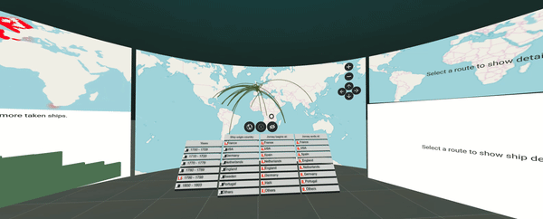
prize papers VR environment
Inverted globe mode (global data)
https://vr.calisto.pt/prizepapers

Slide 18
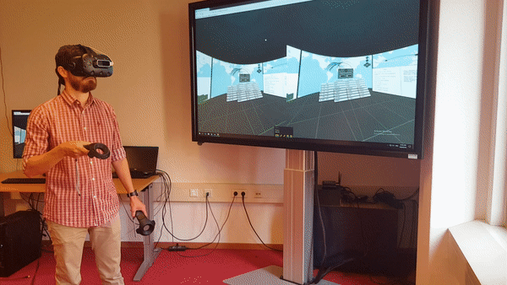
prize papers VR environment
User experience in our VR lab. (Inverted globe)

Slide 19
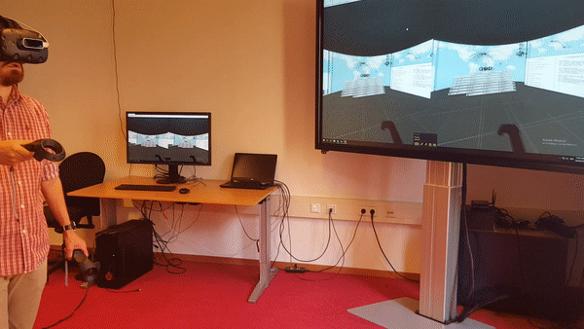
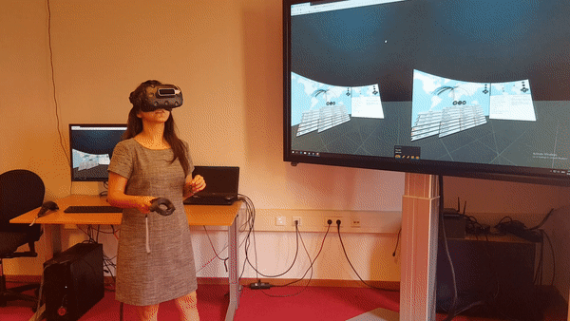
prize papers VR environment
User experience. More testing needed.

Slide 20
Conclusions - Pros
WOW factor!
WebVR can be used for geo data visualization
User is surrounded by data. Immersive experience useful for complex and big datasets;
Any 3d model can be imported. City data, drone data;
Openlayers and other frameworks can be used.

Slide 21
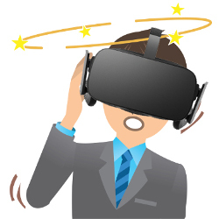
Conclusions - CONS
Very recent technology;
Probably you need to create your components if they don’t exist;
More difficult to implement;
Multiple devices/browsers + recent technology = multiple bugs;
What new techniques can we use? Inverted globe is one, but what else?
Sick motion problems.

Slide 22
Final Conclusions
You can use JavaScript frameworks with A-Frame: Angular; Vue; React …
A-frame was a good choice;
Further research needs to be done;
WPS integration can be an interesting option;
Many new functionalities can be added/created.

Slide 23

aframe-openlayers-component
https://github.com/lcalisto/aframe-openlayers-component
Prize Papers VR environment code
(including this presentation)
https://github.com/lcalisto/prize-papers-VR
The VR environment can be accessed at
https://vr.calisto.pt/prizepapers

